Slide 1

Work Zone Monitoring
Real-Time, Big Data, for Intelligent Transportation Systems
Notes:
I mention the word evolution because that’s exactly what this has been….

Slide 2

Architecture
Notes:
Let me go ahead and get this out of the way.

Slide 3

Data Sources Being Used
HERE Traffic Speeds
Waze Reports
iCones Speeds
Twitter
KYMesonet
CoCoRahs
Doppler Radar
TOC Reports
TRIMARC Reports
Snow Plows (AVL)
Roadway Weather Stations
County Activity Reports
Dynamic Message Signs
Truck Parking
Notes:
Combining all of this data for a single understanding of events.

Slide 4
When you say “Big Data”?
Source | Records per Year
HERE | 2.5 billion
Waze Jams | 128 million
Waze Incidents | 180 million
AVL (Snow Plows) | 175 million
All Others | 123 million
Total Records and Storage: | 3.1 billion and 3TB(x3)
Notes:
The term “big data” is very relative….

Slide 5
Products Being Used
Back-End
  Apache Kafka
  Apache Spark
  Apache Hadoop
  Elasticsearch
User Experience
  Kibana
  ArcGIS Online
Languages
  Python
  Scala
  Java

Slide 6







Data Workflow
Data
Source
1,400 lines of code
400 lines of code
50 lines of code
50 lines of code
No code
50 lines of code

Slide 7
Current and Future Use Cases
Situational Awareness
Incident Detection
Snow and Ice Management
Work Zone Monitoring
Traffic Control Plan Training
Incident and Recovery Times
Research & Data Science
Predictive Analytics*
Secondary Crash Detection*
Congestion Mitigation*
Signal Timing*
Automated DMS Messages*
Automated Bookkeeping*
Environmental*
Notes:
Once that effort was started, use cases came from everywhere.

Slide 8
Incident Detection
Notes:
Incident detection started simply as a way to filter out emails.

Slide 9
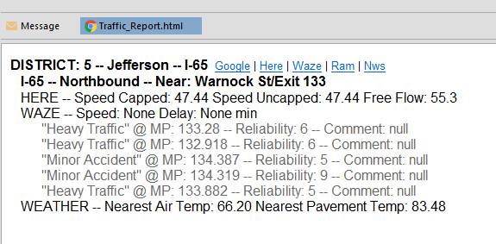
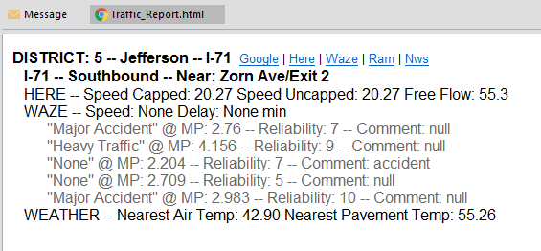

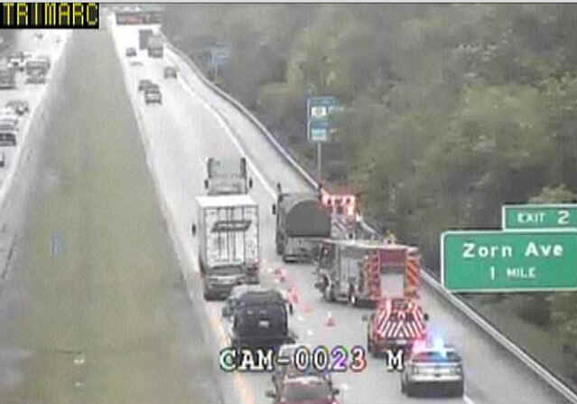
Incident Detection (2015)

Slide 10
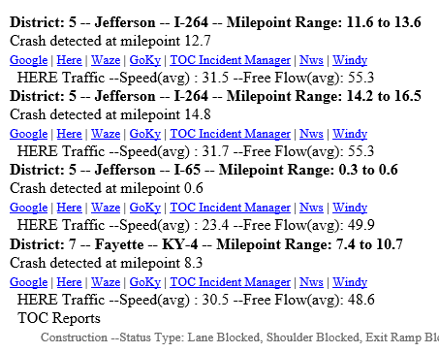
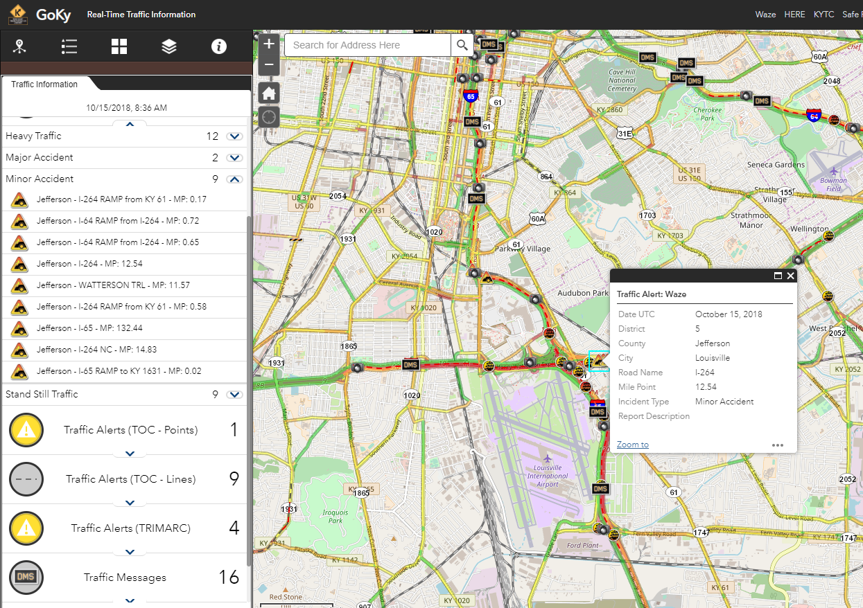
After Action Review: I-264, Map View
Notes:
Launch maps from the email.

Slide 11
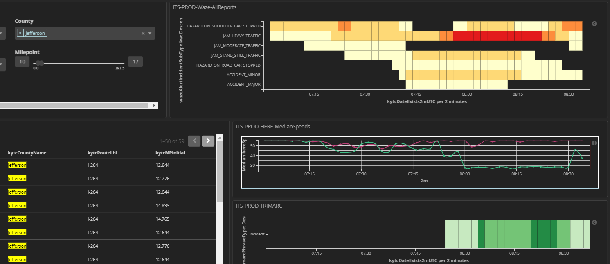
After Action Review: I-264, Dashboard
Notes:
Map is great for awareness but doesn’t truly show the progression of the event.

Slide 12
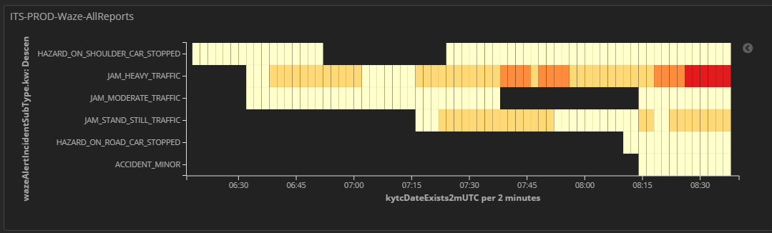
After Action Review: Research Catalyst
Notes:
UK performed a study in the 90s that found 11% of all crashes on the interstate involved a disabled vehicle or a car on the shoulder. With newer forms of data and visualizations, I was alble to quickly review one month of data and found that 69% of crashes that month actually involved a car on the shoulder prior to the crash.

Slide 13
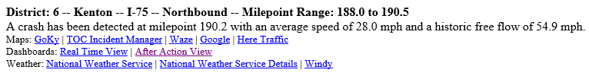
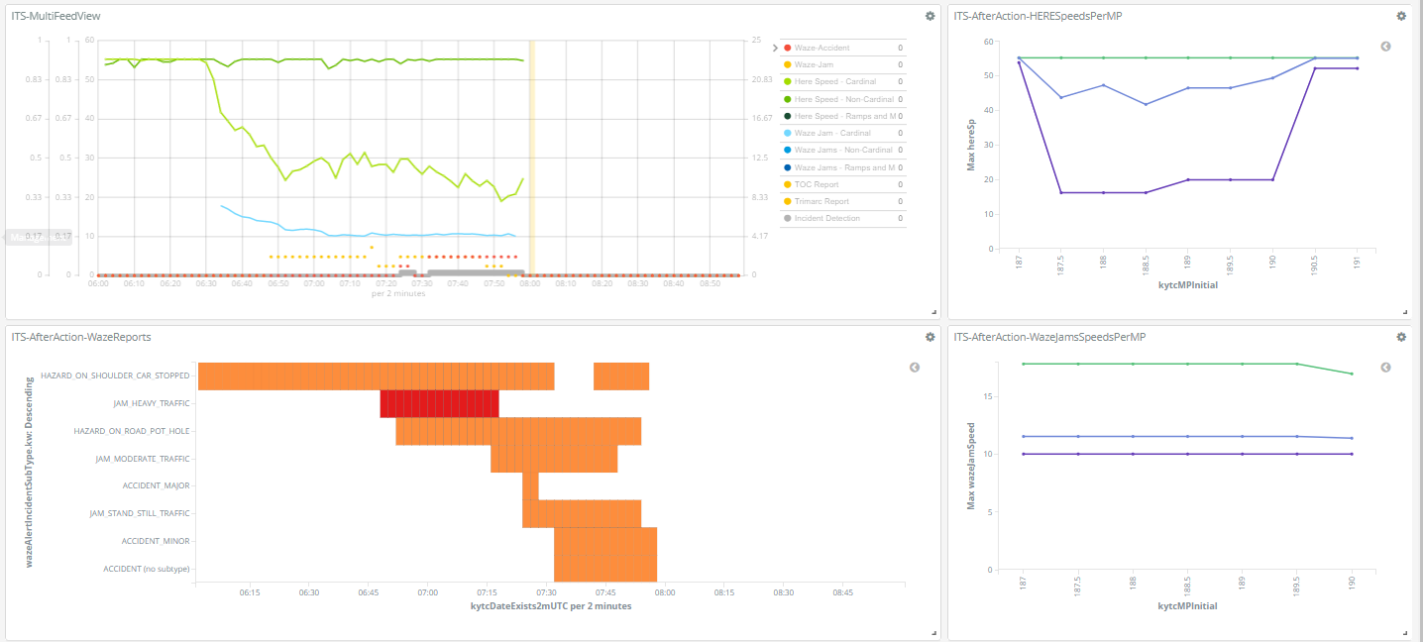
Incident Detection (2019)
Notes:
So now we also add links to after action review dashboards. Notice that we also started placing speeds per mile point on this one.

Slide 14
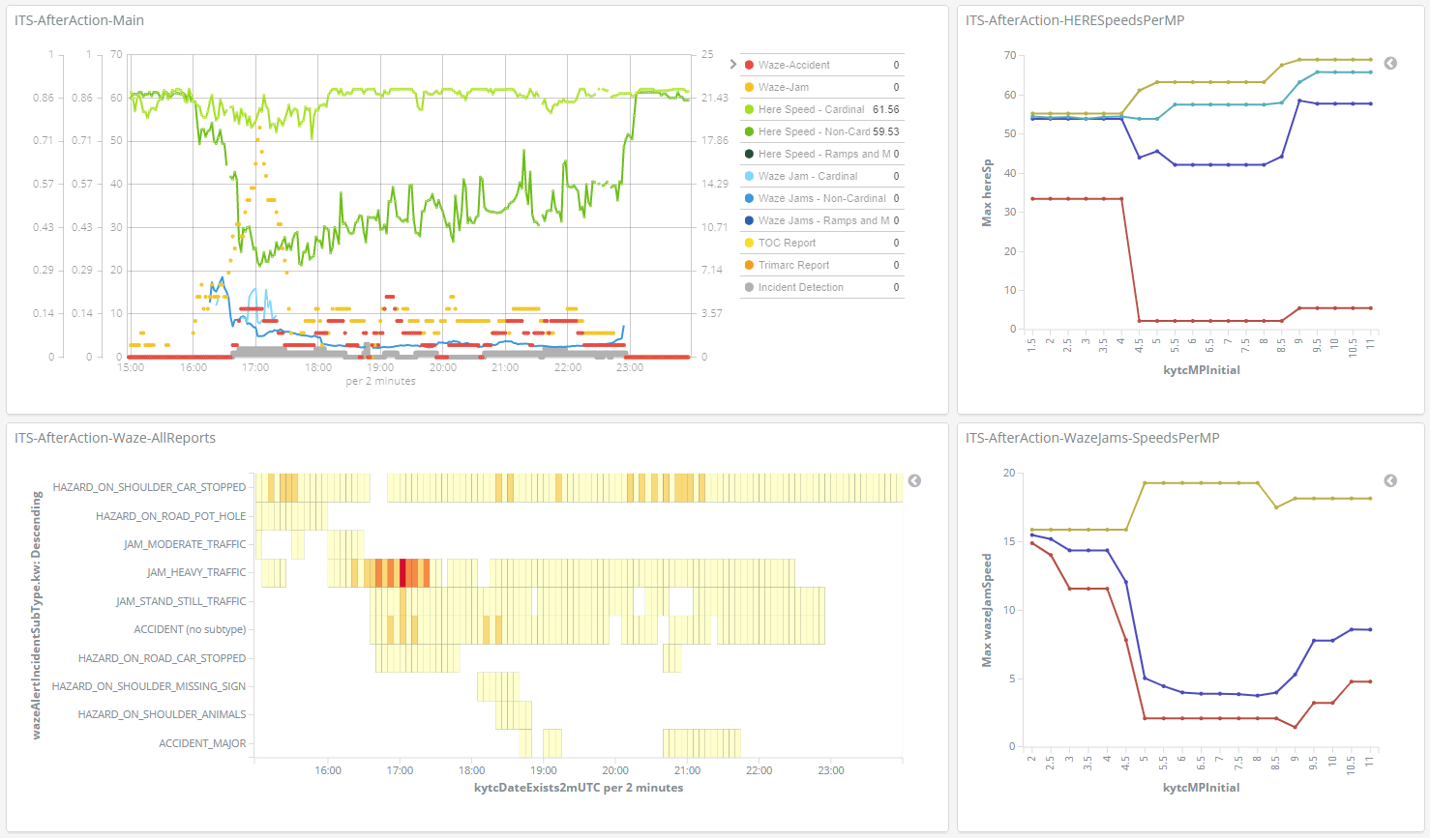
After Action Review (2019)
Notes:
Here’s another example. Notice that we also started placing speeds per mile point on this one.

Slide 15
Work Zone Monitoring
Notes:
So if we can monitor a point, surely we can monitor a line.

Slide 16
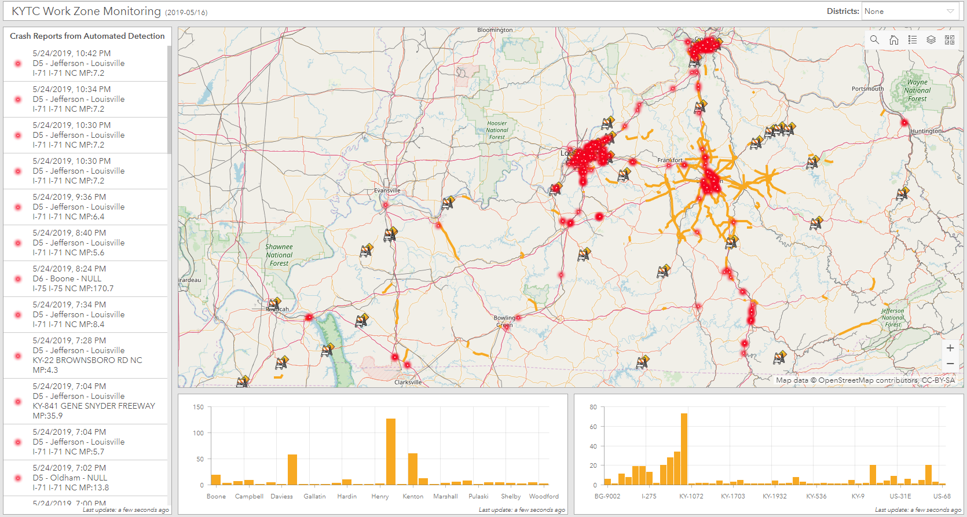
Work Zone Monitoring (2019)
Notes:
We’re testing this with our division of construction’s safety officers this year. They wanted something simple so we gave them a map of work zones and detected incidents.

Slide 17
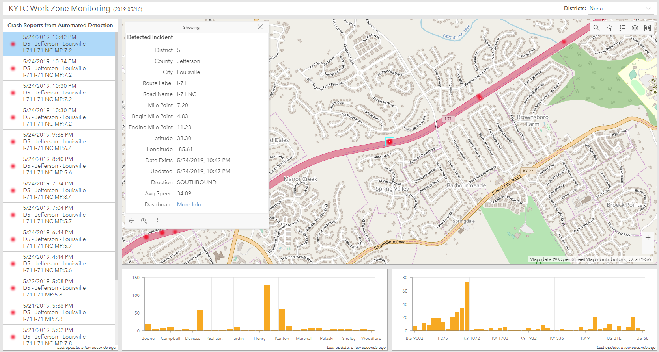
I-71 Work Zone Map View

Slide 18
I-71 Incident Detection Email Alert
Notes:
This is what someone would have received via email. This shows all waze reports so we have context to why this may be happening.

Slide 19
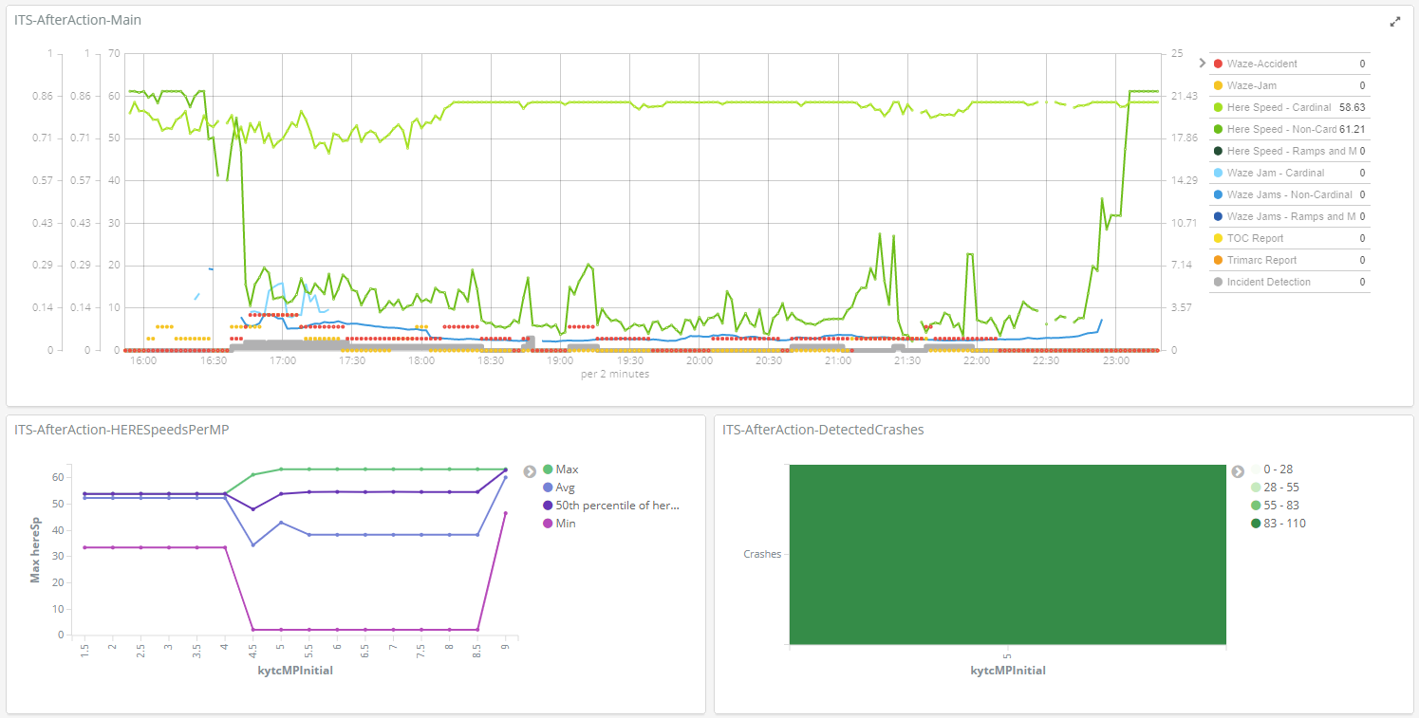
I-71 Work Zone link from Dashboard
Notes:
But if you’re already in a work zone, we launch with a few different visuals. We add in the crashes per mile point as a method for finding secondary crashes. In this case, it lets us know that all of our crash reports are happening within that single mile (5-6) range.

Slide 20
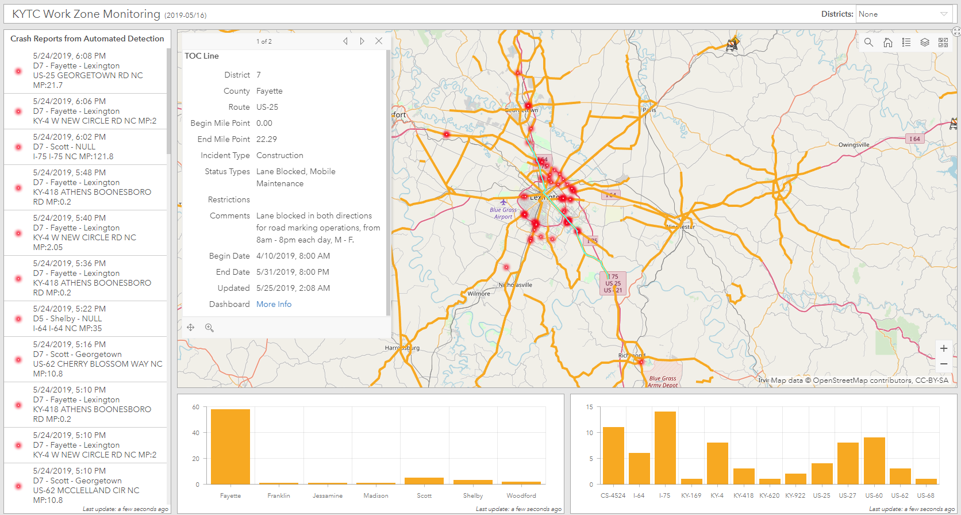
US-25 Work Zone

Slide 21
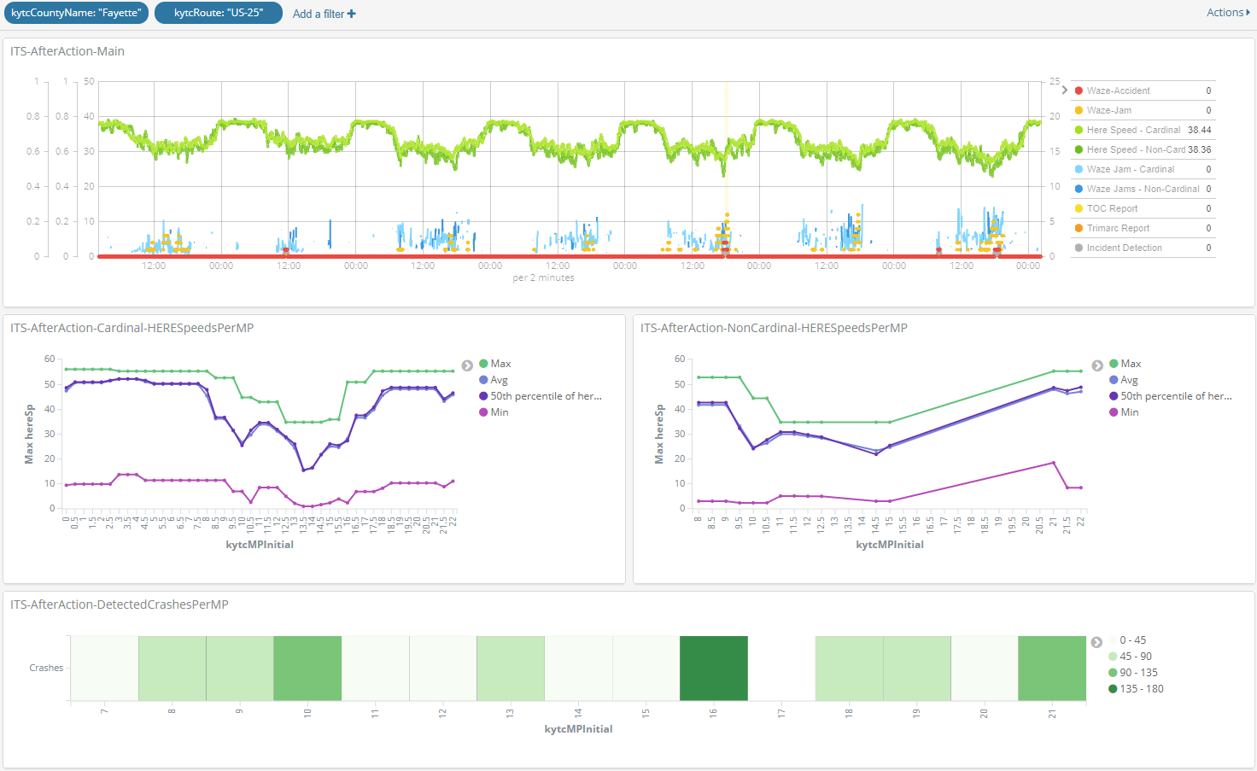
US-25 Work Days
Notes:
This is a view of the entire length of work days for this project. That mile point 5 looks bad.

Slide 22
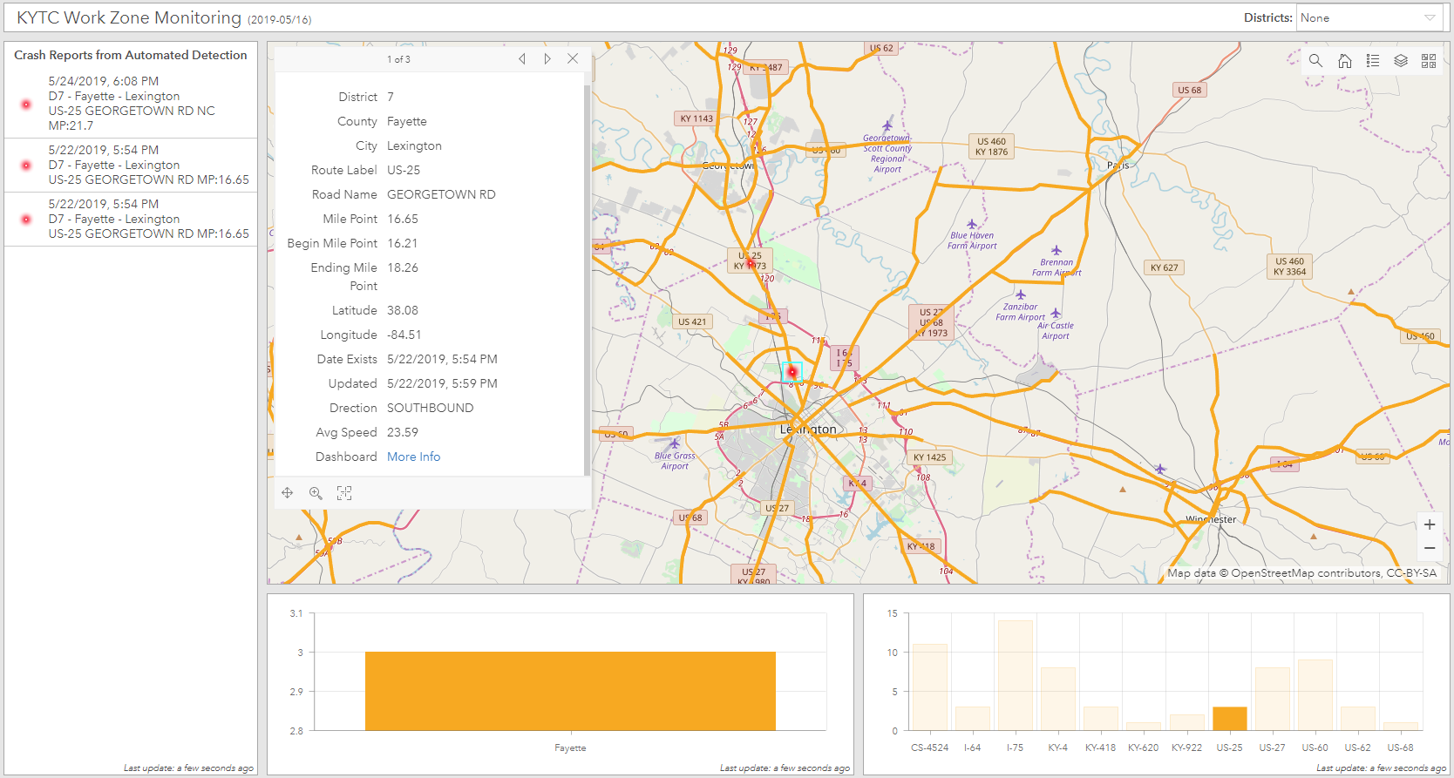
US-25 Work Zone, 7 Day History

Slide 23
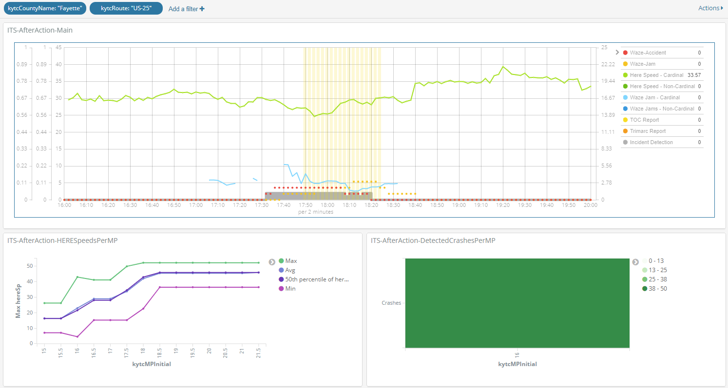
US-25 Work Zone with TMC Report

Slide 24
Future of Transportation Data

Slide 25
Machine Learning Cases
Incident Prediction
Secondary Crash Detection
Extended Work Zone Hours
Signal Timing and Messaging
Notes:
Incident prediction: speeds and car on shoulder
Secondary crashes: 1mile and 90min
Extended Work Zone Hours: accidental find. Expand construction hours.
Signal timing: may go into June letting.

Slide 26
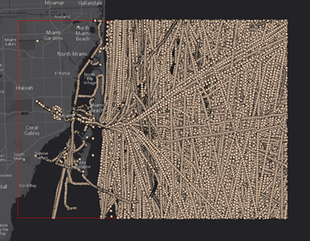
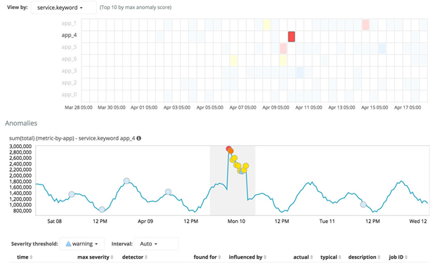

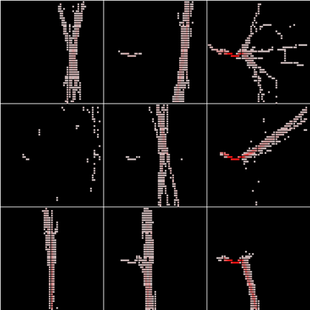

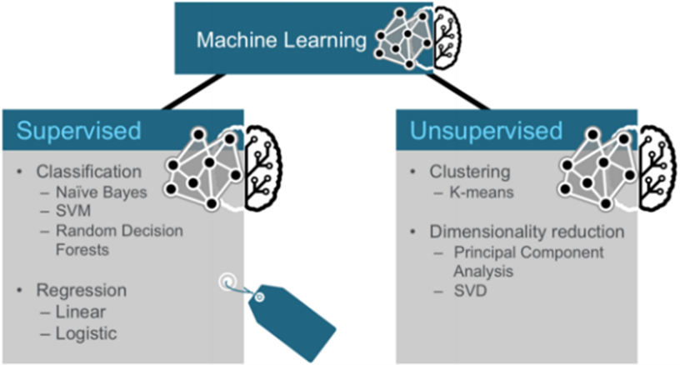

Machine Learning Technologies

Slide 27
Development Team
Venkata Chaganti – Developer
John Fowler – Developer
Jeremy Gould – GIS

Slide 28
Reality Check: This is why!
I-71 NORTHBOUND 8:39am – Waze users report a Minor Accident. 8:52am – HERE speed data starts to show a relevant decline in speeds (59mph vs. 70.21mph historic average) with a Jam Factor greater than 2. 9:12am – Waze Jams data shows a delay of 1.8 minutes and traffic moving at 45mph. | I-71 SOUTHBOUND 9:03am – Waze users report a Minor Accident 9:19am – HERE speed data starts to show a relevant decline in speeds (57mph vs. 70.21mph historic average) with a Jam Factor greater than 2. 9:24am – Waze Jams data shows a delay of 17.11 minutes and traffic moving at 7.35mph. 10:30am - GALLATIN COUNTY, KY (FOX19) - One person died in a crash on Southbound Interstate 71 near the Kentucky Speedway Thursday morning. The crash happened off the side of the road near the 57-mile marker around 10:30 a.m., according to Gallatin County dispatchers.

Slide 29


Slide 30

CONTACT INFORMATION
Chris Lambert, Systems Consultant
chris.lambert@ky.gov
859-619-7757
Twitter: @KYTC | @ChrisLambertKY
facebook.com/kytc120

